Slide 1
CHEM SEC 203
SECTION D
Cosmetics

Slide 2
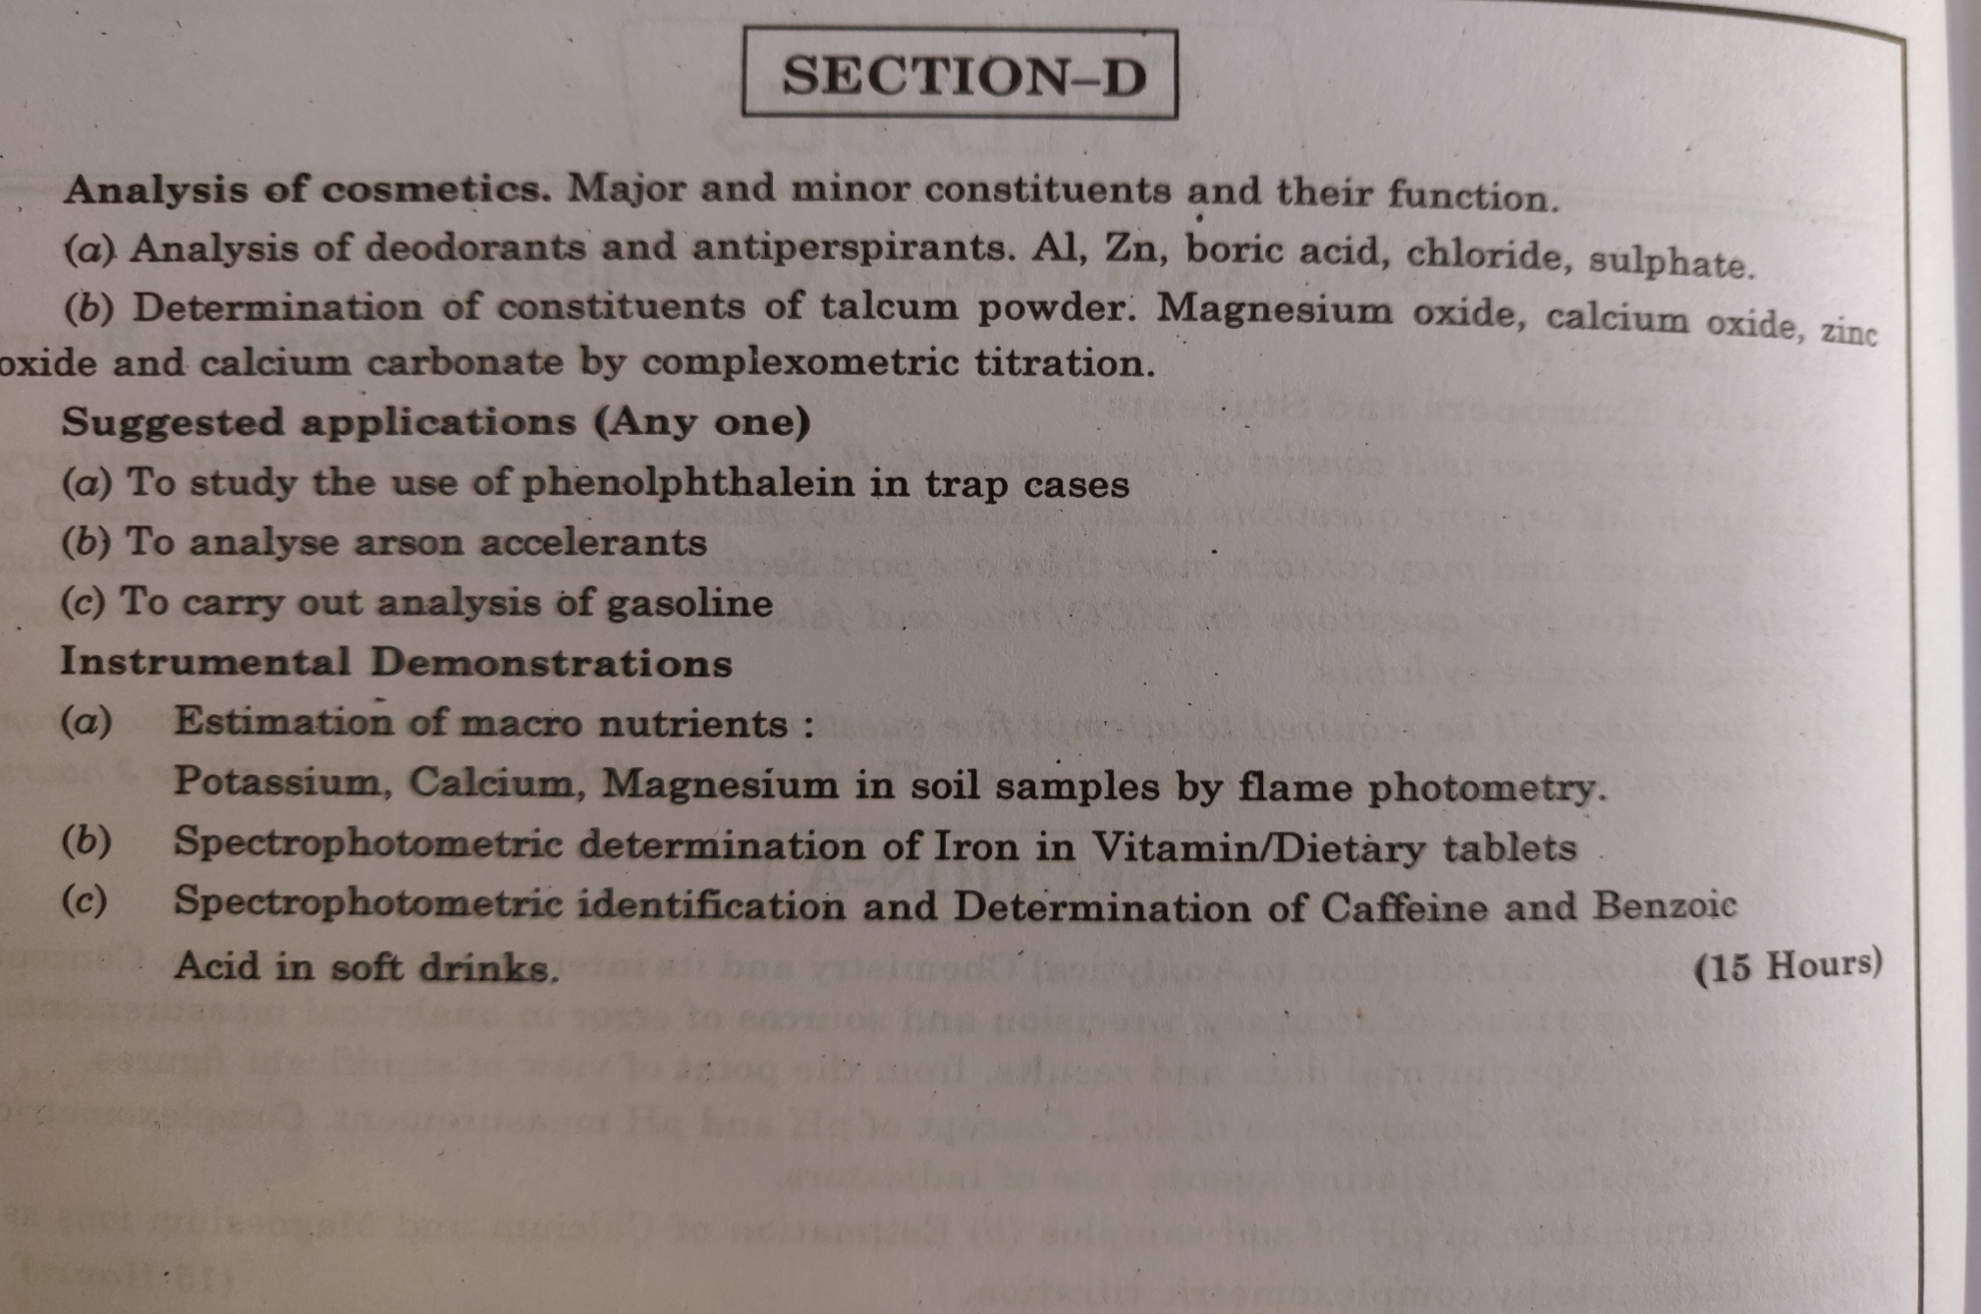
SYLLABUS

Slide 3
TOPICS FOR THIS LECTURE
Definition,major and minor constituents of cosmetics.
Functions of constituents of cosmetics.
Deodorants and antiperspirants.
Analysis of deodorants and antiperspirants .Al ,Zinc,Boric Acid,Chloride,Sulphate.

Slide 4
DEFINITION OF COSMETICS
.The Federal Food, Drug & Cosmetic Act (FD&C Act) defines cosmetics as "articles intended to be rubbed, poured, sprinkled, or sprayed on, introduced into, or otherwise applied to the human body...for cleansing, beautifying, promoting attractiveness, or altering the appearance."
In the United States, the Food and Drug Administration (FDA), which regulates cosmetics, defines cosmetics as products "intended to be applied to the human body for cleansing, beautifying, promoting attractiveness, or altering the appearance without affecting the body's structure or functions".

Slide 5
CONSTITUENTS OF COSMETICS
Most cosmetics contain a combination of at least some of the following core ingredients: water, emulsifier, preservative, thickener, emollient, colour, fragrance and pH stabilisers.
Some of these are major constituents and some are minor constituents.

Slide 6
WATER(Major Constituent)
Water forms the basis of almost every type of cosmetic product, including creams, lotions, makeup, deodorants, shampoos and conditioners. Water plays an important part in the process, often acting as a solvent to dissolve other ingredients and forming emulsions for consistency.
It must be ‘ultra-pure’—that is, free from microbes, toxins and other pollutants.

Slide 7
EMOLLIENTS(Major Constituent)
Emollients soften the skin by preventing water loss. They are used in a wide range of lipsticks, lotions and cosmetics. A number of different natural and synthetic chemicals work as emollients, including beeswax, olive oil, coconut oil and lanolin, as well as petrolatum (petroleum jelly), mineral oil, glycerine, zinc oxide, butyl stearate and diglycol laurate.

Slide 8
EMULSIFIERS(Major Constituent)
The term emulsifiers refers to any ingredient that helps to keep unlike substances (such as oil and water) from separating. Many cosmetic products are based on emulsions—small droplets of oil dispersed in water or small droplets of water dispersed in oil.
Examples of emulsifiers used in cosmetics include polysorbates, laureth-4, and potassium cetyl sulfate.

Slide 9
THICKENERS(Major Constituent)
Thickening agents work to give products an appealing consistency. They can come from four different chemical families:
Lipid thickeners are usually solid at room temperature but can be liquefied and added to cosmetic emulsions. They work by imparting their natural thickness to the formula. Examples include cetyl alcohol, stearic acid and carnauba wax.
Naturally derived thickeners come, as the name suggests, from nature. They are polymers that absorb water, causing them to swell up and increase the viscosity of a product. Examples include hydroxyethyl cellulose, guar gum, xanthan gum and gelatin. Cosmetics with a consistency that is too thick can be diluted with solvents such as water or alcohol.
Mineral thickeners are also natural, and as with the naturally derived thickeners mentioned above, they absorb water and oils to increase viscosity, but give a different result to the final emulsion than the gums. Popular mineral thickeners include magnesium aluminium silicate, silica and bentonite.
The final group are the synthetic thickeners. They are often used in lotion and cream products. The most common synthetic thickener is carbomer, an acrylic acid polymer that is water-swellable and can be used to form clear gels. Other examples include cetyl palmitate, and ammonium acryloyldimethyltaurate.

Slide 10
PIGMENTS(Major constituent)
Pigments can be split into two main categories: organic, which are carbon-based molecules (i.e. organic in the chemistry context, not to be confused with the use of the word to promote ‘natural’ or ‘non-synthetic’ or ‘chemical-free’ products) and inorganic which are generally metal oxides (metal + oxygen and often some other elements too). Inorganic should not be confused with ‘synthetic’ or ‘unnatural’ as most of the inorganic metal oxide pigments do occur naturally as mineral compounds.
The two most common organic pigments are lakes and toners. The lake pigments are made by combining a dye colour with an insoluble substance like alumina hydrate. This causes the dye to become insoluble in water, making it suitable for cosmetics where water-resistant or waterproof properties are desired.
A toner pigment is an organic pigment that has not been combined with any other substance.
The inorganic metal oxide pigments are usually duller than the organic pigments, but are more resistant to heat and light, providing a longer-lasting colour.

Slide 11
SHIMMERS(Minor constituent)
Shimmering effects can be created via a range of materials. Some of the most common ones are mica and bismuth oxychloride.
Cosmetic mica typically comes from muscovite (KAl₂(AlSi₃O₁₀)(F,OH)₂) also known as white mica. It naturally forms in flaky sheets and these are crushed up into fine powders. The tiny particles in the powders refract (bend) light, which creates the shimmering effect common in many cosmetics. Mica coated with titanium dioxide gives a whitish appearance when looked at straight on, but then produces a range of iridescent colours when viewed from an angle.
Bismuth oxychloride (BiClO) is used to create a silver grey pearly effect. This compound occurs naturally in the rare mineral bismoclite, but is usually produced synthetically and so is also known as synthetic pearl.
The size of the particles used to create pearly and shimmering looks affect the degree of glimmer the product has. The smaller the particle size (15–60 microns, where one micron is one millionth of a meter), the less lustrous the powder will be, and more coverage it gives. Larger particle sizes, up to 500 microns, give a more glittery lustre and are more transparent.

Slide 12
FRAGRANCES/PERFUMES
(Minor constituent)
.
Chemicals, both natural and synthetic, are added to cosmetics to provide an appealing fragrance. Even ‘unscented’ products may contain masking fragrances to mask the smell of other chemicals.
The term ‘fragrance’ is often a generic term used by manufacturers. A single listing of fragrance on your product’s ingredient list could represent dozens or even hundreds of unlisted chemical compounds which were used to create the final individual fragrance.
Manufacturers do not have to list these individual ingredients as fragrance is considered to be a trade secret.
There are over 3,000 chemicals used to formulate the huge range of fragrances used in consumer products worldwide. A comprehensive list has been published by the fragrance industry. All the ingredients on this list have passed the International Fragrance Association (IFRA) safety standards for use in commercial products

Slide 13
Parabens (Minor constituent)
Parabens are a class of chemicals commonly used as preservatives in food, therapeutic and cosmetic products. They are derived from para-hydroxybenzoic acid (PHBA), which occurs naturally in many fruits and vegetables. Parabens come in several forms: methylparaben, ethylparaben, propylparaben, butylparaben and isobutylparaben. They are the most widely used preservative in personal care products. This is because they are incredibly good at doing their job—keeping your products mould and bacteria free—and are also cost effective.

Slide 14
Aluminium (Minor Constituent)
Concerns regarding cancer are also linked to the use of aluminium in deodorants and anti-perspirants. In the early 2000s various news outlets reported apparent links between the use of antiperspirants containing aluminium and breast cancer. Similar reports connected the use of such products to the onset of Alzheimer’s disease. These supposed links have never been scientifically proven despite multiple studies.
Aluminium works to block the sweat ducts to reduce sweating. Some argue that this process prevents us from releasing toxins, causing them to build up within our lymph glands.

Slide 15
Triclosan (Minor constituent)
Triclosan was originally developed as an anti-bacterial agent for use in hospitals, primarily as a surgical scrub. However its usefulness has seen it increasingly added to a wide range of consumer products including deodorant, soap, toothpaste, cosmetics and general house-hold cleaning products..
Triclosan hit the news in 2000 after findings published by the National Academy of Sciences (US) noted rising levels of the chemical being detected in the environment and its increasingly broad use in everyday products as concerns.
Studies conducted by scientists at the University of California found that prolonged exposure to triclosan causes liver fibrosis and cancer in laboratory mice. Other studies have suggested triclosan can disrupt hormones, impair muscle contraction and reduce bacterial resistance.
In Australia, a full risk assessment conducted by NICNAS found no cause for public concern in general, though did recommend controls for maximum concentrations of triclosan (0.3%) in personal care and cosmetic products. At present, cosmetic products containing more than 0.3% triclosan must clearly carry the word ‘poison’ on the label—not the best marketing strategy for producers.

Slide 16
PRESERVATIVES(Minor Constituent)
Preservatives are important ingredients. They are added to cosmetics to extend their shelf life and prevent the growth of microorganisms such as bacteria and fungi, which can spoil the product and possibly harm the user. Since most microbes live in water, the preservatives used need to be water-soluble, and this helps to determine which ones are used. Preservatives used in cosmetics can be natural or synthetic (man-made), and perform differently depending on the formulation of the product. Some will require low levels of around 0.01%, while other will require levels as high as 5%.
Some of the more popular preservatives include parabens, benzyl alcohol, salicylic acid, formaldehyde and tetrasodium EDTA (ethylenediaminetetra-acetic acid).

Slide 17
Deodorants and Antiperspirants
A deodorant is a substance applied to the body to prevent or mask body odor due to bacterial breakdown of perspiration in the armpits, groin, and feet, and other parts of body.
A subclass of deodorants, called antiperspirants, prevents sweating itself, typically by blocking sweat glands. Antiperspirants are used on a wider range of body parts, at any place where sweat would be inconvenient or unsafe, since unwanted sweating can interfere with comfort, vision, and grip (due to slipping).
Other types of deodorant allow sweating but prevent bacterial action on sweat, since human sweat only has a noticeable smell when it is decomposed by bacteria.

Slide 18
Why deodorants are better?
Deodorant products work in one of two ways – by preventing sweat from occurring, or by allowing it to occur but preventing bacterial activity that decomposes sweat on the skin.
Deodorants have antiseptic action against bacteria.
Antiperspirant works by clogging .closing,blocking the pores of the skin with aluminium ions so that they cannot release perspiration.
Deodorants are healthier option than antiperspirants because they do not interfere with the perspiration.

Slide 19
INGREDIENTS OF DEODORANTS AND ANTIPERSPIRANTS
The main ingredients of deodorants and antiperspirants include :
Aluminium salts as active ingredient to control sweating
Antimicrobials to kill bacteria
Fragrances to mask body odour.
Emollient oils to soften skin
Water as acarrier to add fluidity to creams
Cyclomethicone in aerosol products
Parabens as preservatives in antiperspirants
Butane ,isobutane as propellants

Slide 20
Analysis of deodorants and antiperspirants
The analysis of deodorants and antiperspirants for Aluminium and other metals is done by ATOMIC ABSORPTION SPECTROSCOPY.This technique is used for quantitative estimation of trace metals in liquids.By this technique determination can be made in the presence of other elements also.

Slide 21
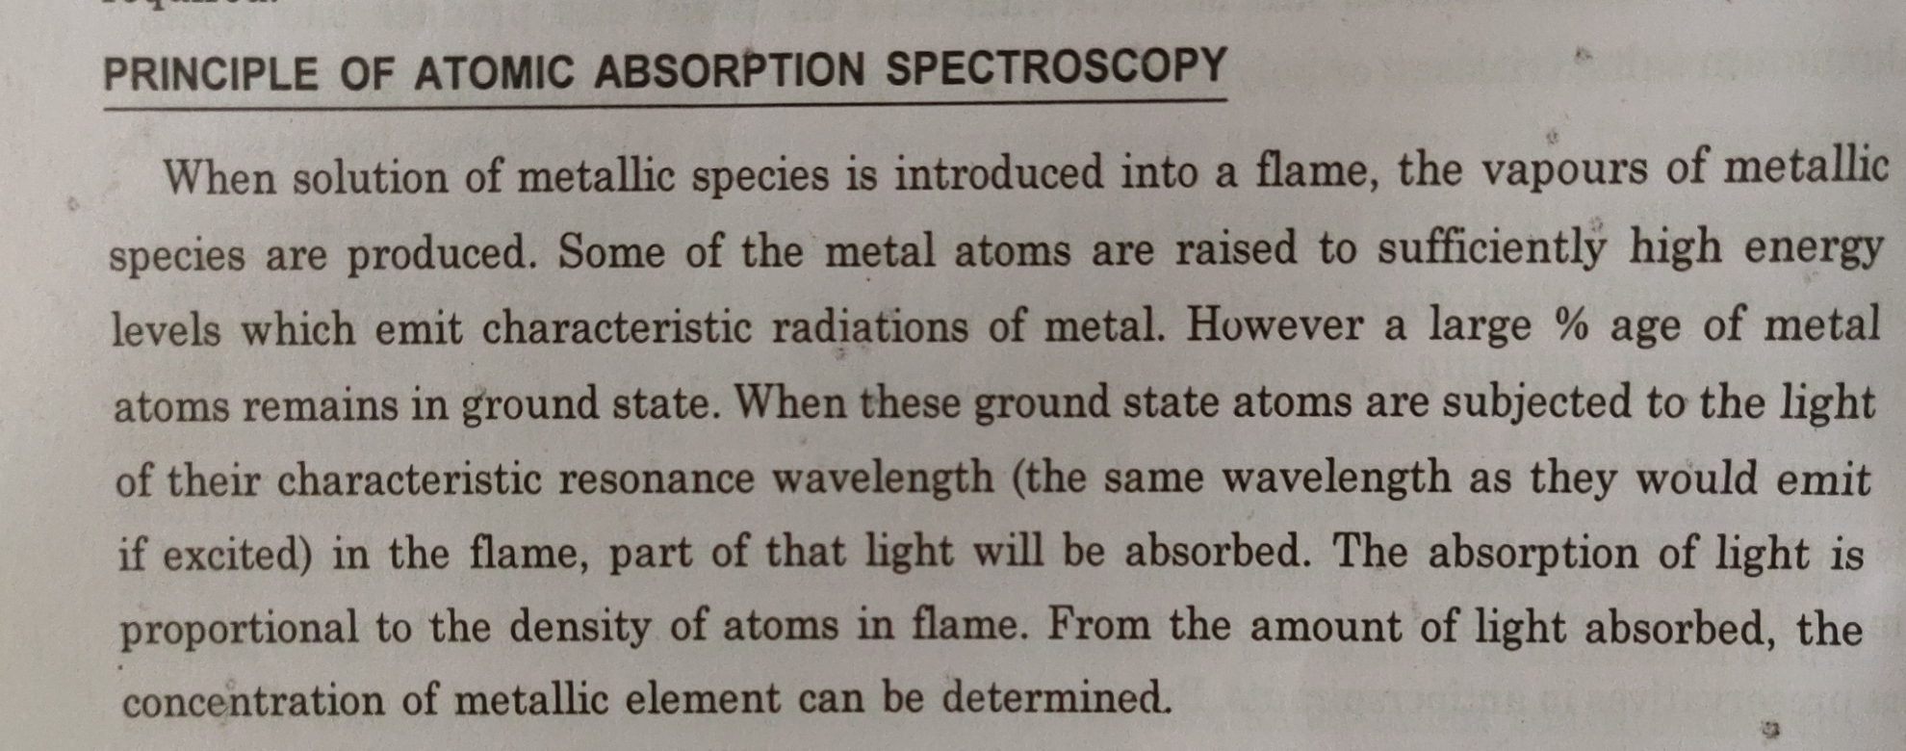
PRINCIPLE OF ATOMIC ABSORPTION SPECTROSCOPY

Slide 22
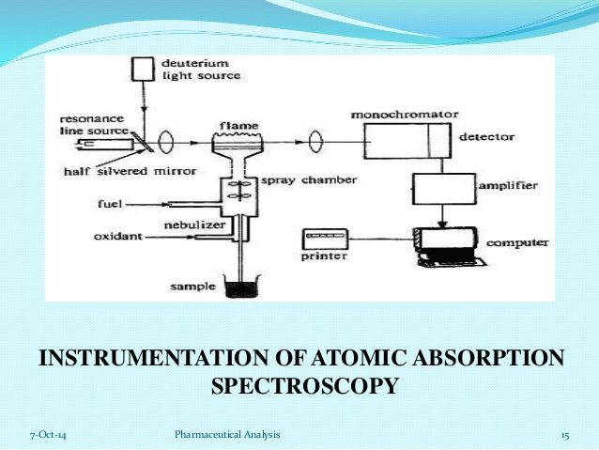
Instrumentation of ATOMIC ABSORPTION SPECTROSCOPY

Slide 23
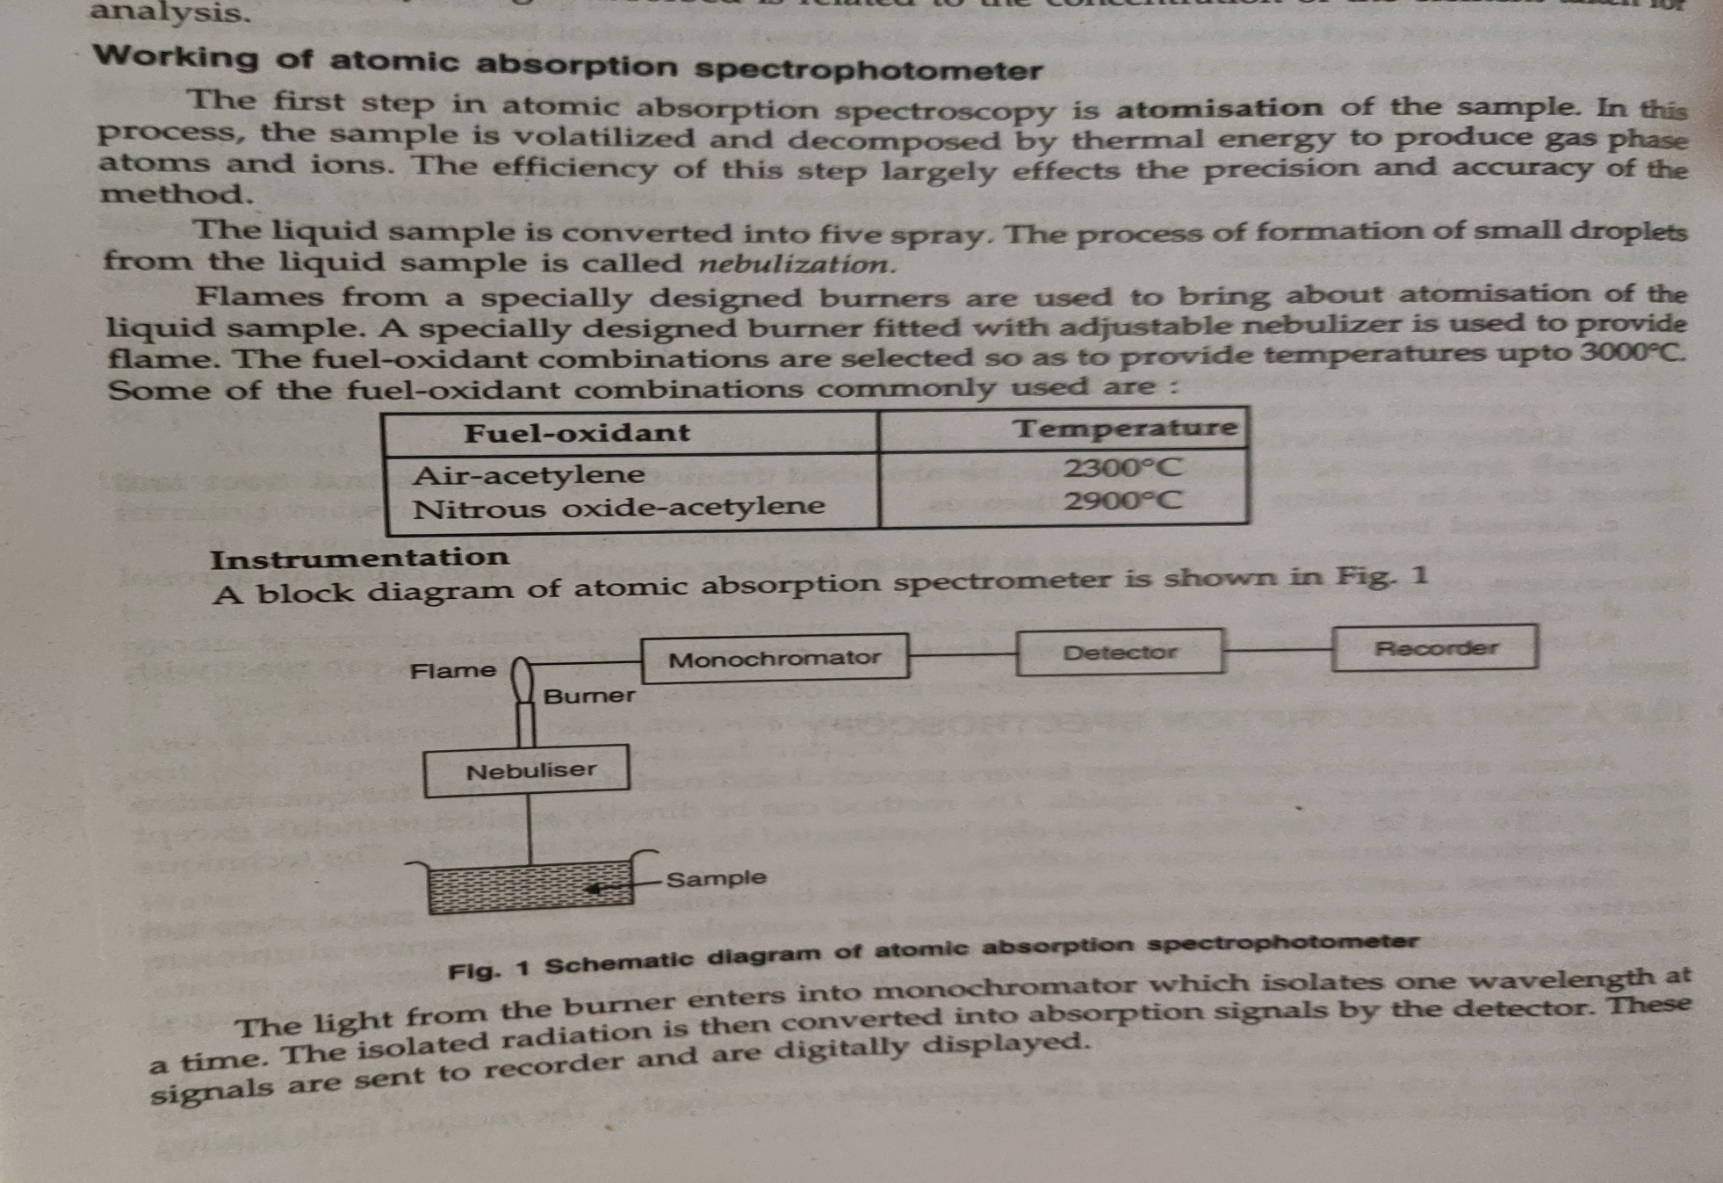
Working of AAS

Slide 24
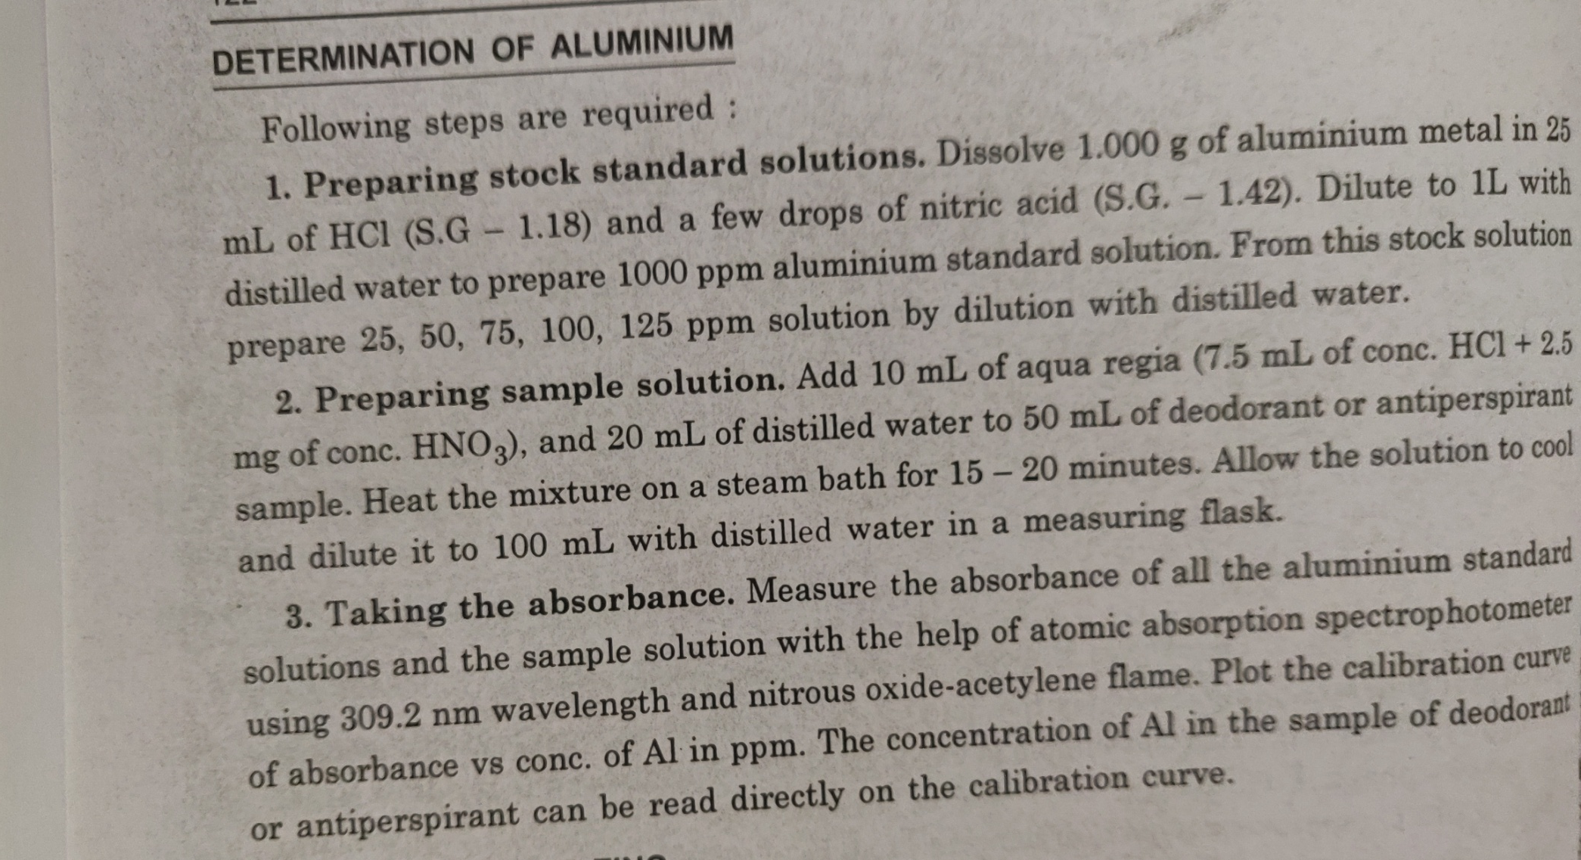
Analysis of deodorants and antiperspirants(ALUMINIUM)

Slide 25
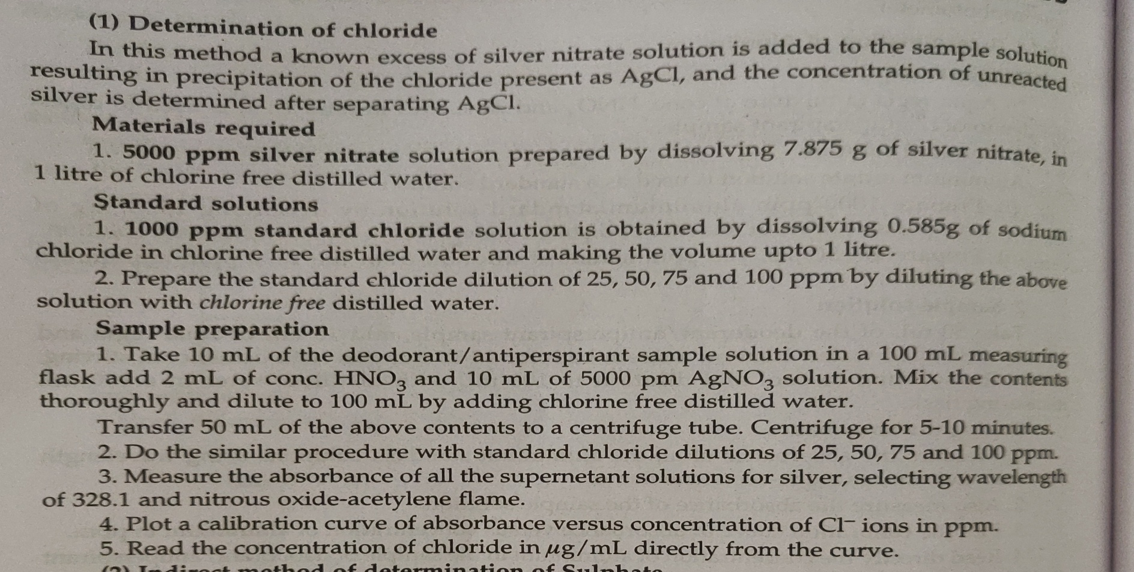
Analysis (chloride)

Slide 26
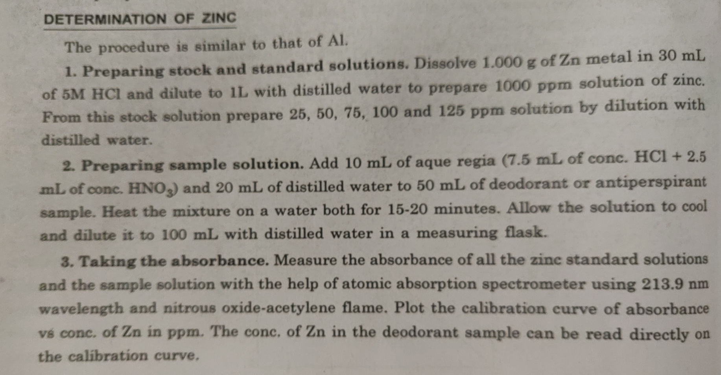
Analysis (Zinc)

Slide 27
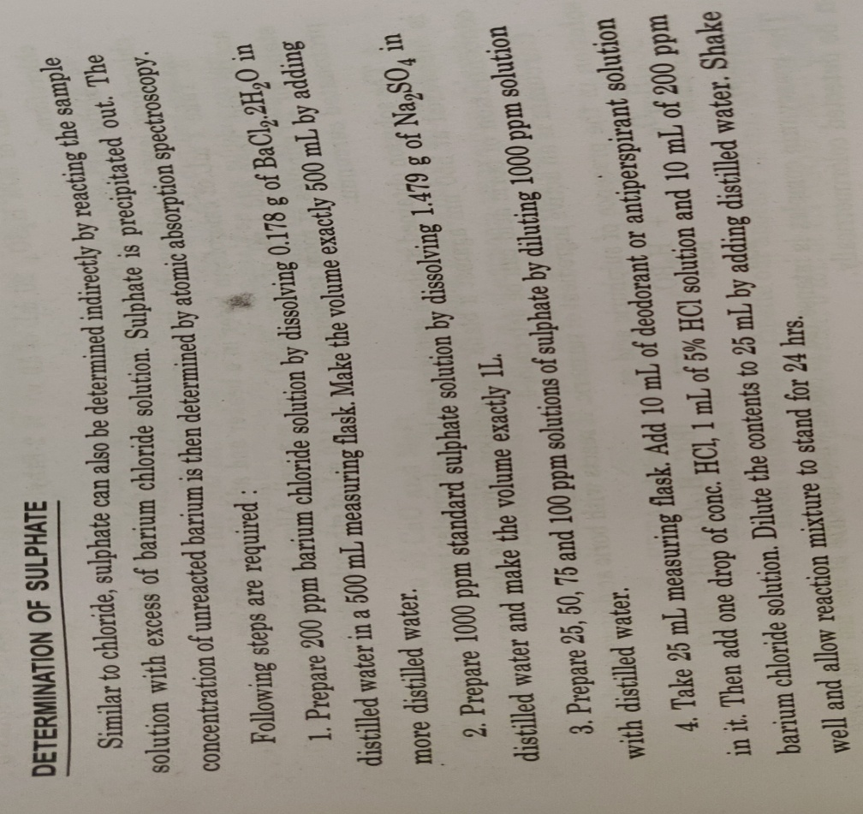
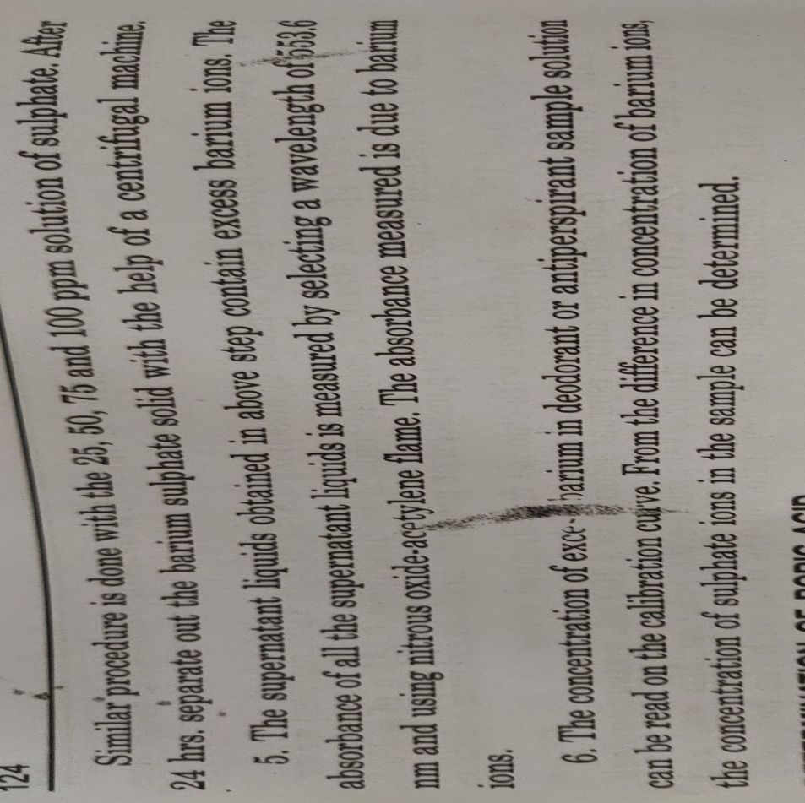
Analysis (Sulphate)

Slide 28
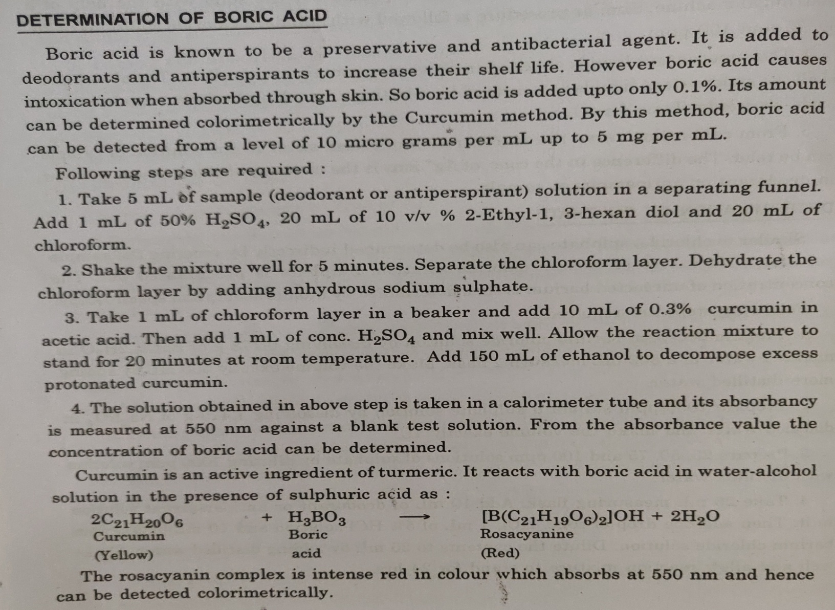
Analysis (BORIC ACID)

Slide 29
REFERENCES
https://www.science.org.au/curious/people-medicine/chemistry-cosmetics
Basic Analytical Chemistry by Darshan kumar,S.Kalia
Basic Analytical Chemistry by S Kiran,Kavya

Slide 30
Q1 Explain various techniques to analyse deodorants and antiperspirants
Q2 Why boric acid is added to deodorants and antiperspirants
Q3 How do antiperspirants work to reduce body odour?
Q4 Give an account of various thickeners present in cosmetics?
How will you determine Chloride in a sampke of antiperspirant?
THANX WITH A NOTE THAT KINDLY TRY THE QUESTIONS GIVEN ON THIS SLIDE

